Slide 1
AngelinGifty J
Final Project
3/21/2024 Annual Review
1

Slide 2
Handwritten Digit Recognition Using Python
3/21/2024 Annual Review
2

Slide 3


AGENDA
Introduction to Handwritten Digit Recognition.
Dataset description and preprocessing steps.
Model architecture and training process.
Evaluation results, conclusion, and future prospects.
3/21/2024 Annual Review
3

Slide 4

PROBLEM STATEMENT
Develop a Python-based system capable of accurately recognizing handwritten digits, utilizing machine learning techniques, and deploying a model that can classify digits with high accuracy for various practical applications such as digit recognition in forms, postal code sorting, and digitized document processing.
3/21/2024 Annual Review
4

Slide 5

PROJECT OVERVIEW
The project focuses on implementing handwritten digit recognition using Python. It involves dataset preprocessing, model
building with machine learning or deep learning techniques, and deploying the model for practical use. The goal is to accurately classify handwritten digits, enabling applications like digitized document processing and postal code sorting.
3
/21/2024 Annual Review
5

Slide 6
WHO ARE THE END USERS?
The end users of the handwritten digit recognition system can vary depending on the specific application, but potential users may include:
Businesses
Researchers
Developers
General Public
3/21/2024 Annual Review
6

Slide 7


YOUR SOLUTION AND ITS VALUEPROPOSITION
The end users of the handwritten digit recognition system can vary depending on the specific application, but potential users may include:
Businesses: Companies involved in digitized document processing, postal services, or any operation requiring automated recognition of handwritten digits.
Researchers: Individuals or teams conducting research in machine learning, computer vision, or handwriting recognition.
Developers: Software developers interested in integrating digit recognition capabilities into their
applications, such as form processing software or mobile applications.
General Public: Users of applications that utilize digit recognition, such as mobile banking apps
3
/21/2024 Annual Review
7

Slide 8

THE WOW IN YOUR SOLUTION
or online forms, may indirectly benefit from improved accuracy and efficiency in digit.
Developing a Python-based handwritten digit recognition system offers automation, accuracy, and efficiency,
benefiting businesses,researchers, and users through streamlined processes, improved data quality
3/21/2024 Annual Review
8

Slide 9
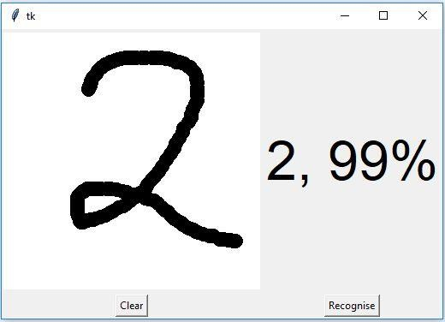
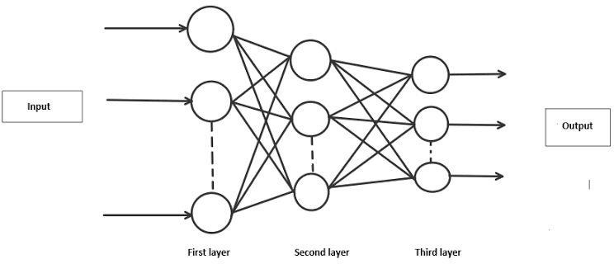
MODELLING
3
/21/2024 Annual Review
9

Slide 10
Results
The model achieved an accuracy of 93% on the test dataset, demonstrating its effectiveness in accurately recognizing handwritten digits
3/21/2024 Annual Review
10

